Slide 1

  Landslides
  Lesson 1: Modeling Landslides

Slide 2
Guiding Question
How can people prepare for the effects of the changing landscape on property?

Slide 3
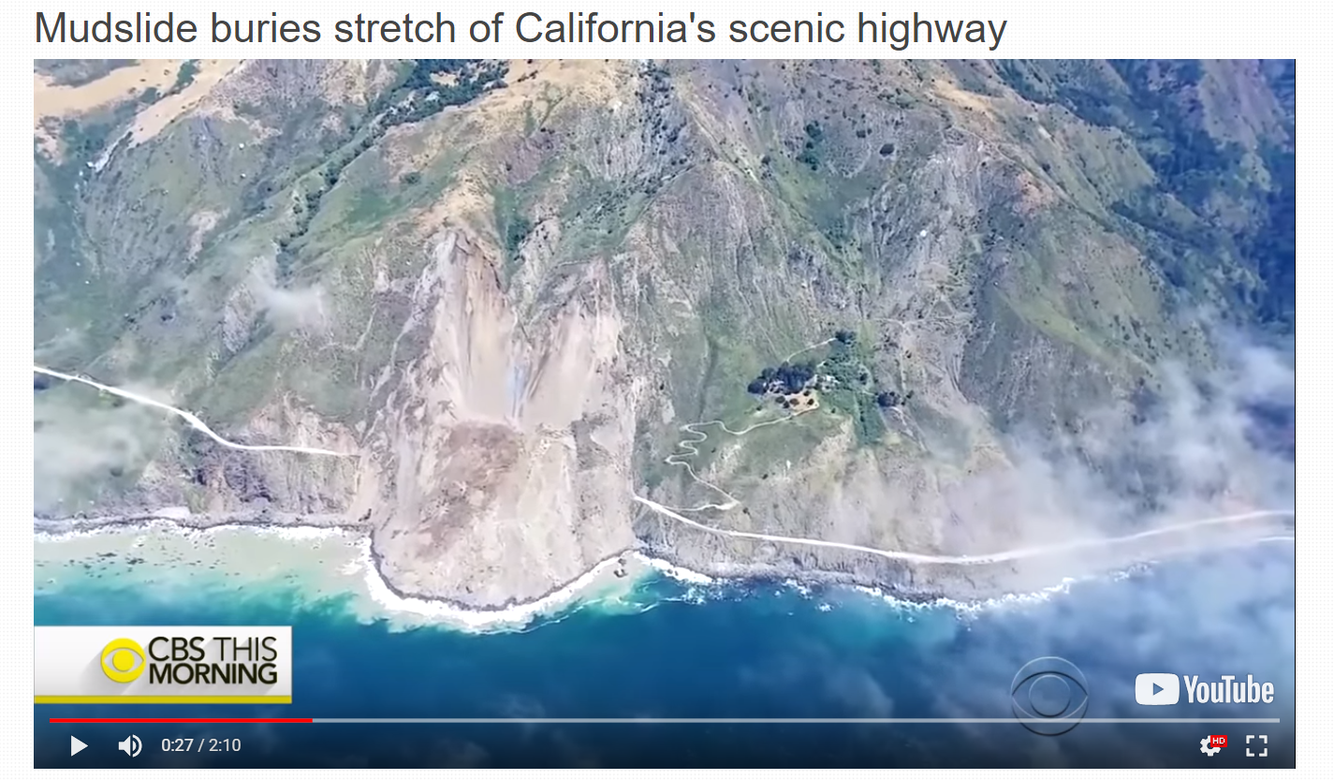
Pacific Coast Highway Landslide
Make observations and think about any questions you have about your observations.
How do your observations relate to the question below?
How can people prepare for the effects of the changing landscape on property?

Slide 4
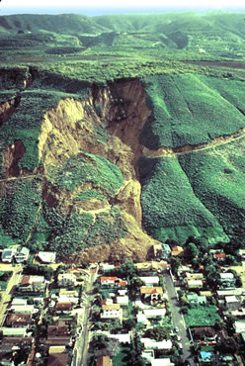
Where do Landslides occur in California?
What do you notice?
What do you wonder?
What does this remind you of?

Slide 5
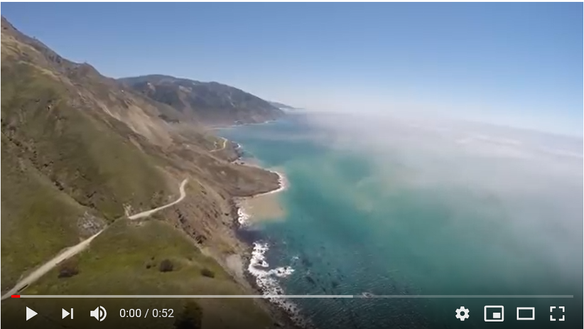
AERIAL FOOTAGE OF THE MUD CREEK LANDSLIDE
https://www.youtube.com/watch?v=GCSimHiFNDA

Slide 6

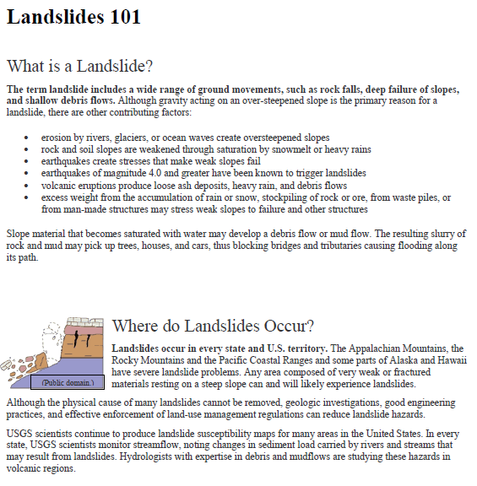
Landslides
Underline where the reading defines a landslide.
Put a star ( ) for examples of the causes of a landslide.
Add a question mark (?) in places where you have questions about the information.

Slide 7
Mud Creek Concept Sketch
Draw a concept sketch of the Mud Creek landslide.
What is a concept sketch? A concept sketch your initial thinking and model that represents a scientific concept or new idea.

Slide 8
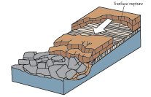
Landslide Concept Sketch Components
Draw arrows to show the direction of debris flow.
Include features unique to the Mud Creek Landslide (highway, beach and ocean).

Slide 9
Exit Ticket
“How can people prepare for the effects of the changing landscape on property?”
What do you think causes landslides? What factors exist for landslides to exist?

Slide 10
THANK YOU
Questions?

